Slide 1
Machine Learning for AI
Raghavendra Nagaraja Rao

Slide 2
Regression Algorithms

Slide 3
WHAT IS REGRESSION?
Making predictions when the target or the label is continuous numeric variable
Features
bedrooms | bathrooms | sqft_living | sqft_above | grade | price
3 | 1 | 1180 | 1180 | 7 | 221900
3 | 2.25 | 2570 | 2170 | 7 | 538000
2 | 1 | 770 | 770 | 6 | 180000
4 | 3 | 1960 | 1050 | 7 | 604000
3 | 2 | 1680 | 1680 | 8 | 510000
4 | 4.5 | 5420 | 3890 | 11 | 1225000
3 | 2.25 | 1715 | 1715 | 7 | 257500
3 | 1.5 | 1060 | 1060 | 7 | 291850
3 | 1 | 1780 | 1050 | 7 | 229500
Target
Notes:
Feature or independent or predictor or explanatory
Target or response or dependent

Slide 4
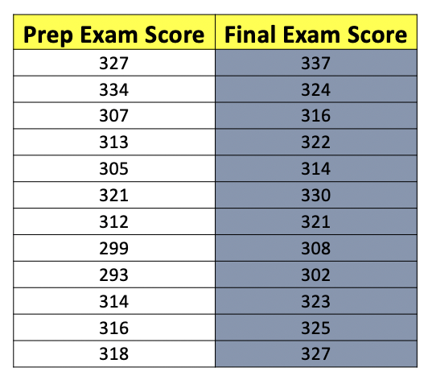
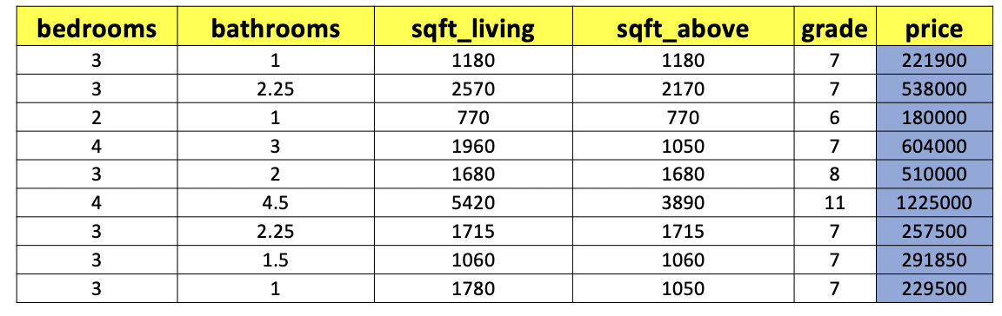
Regression Algorithms
What are the types of regression algorithms?
Simple Linear regression
Multiple Linear regression

Slide 5

Simple Linear Regression
When the value of the feature (X) is known, then this knowledge helps to predict the value of the target(y)
Where:
x = Independent Variable (we provide this)
y = Dependent Variable (we observe this)
β₀ = Y-Intercept
β₁ = Slope
ε = Error

Slide 6
Understanding Simple Linear Regression
https://phet.colorado.edu/sims/html/least-squares-regression/latest/least-squares-regression_en.html

Slide 7
Simple Linear Regression
Assume a sample data with X and y
X: x1, x2, x3, x4, x5, x6, x7,……..
y:y1, y2, y3, y4, y5, y6, y7…….
A Line is drawn through all the points, and the square of the deviation from each point is the residual error
The line is adjusted such that the sum of the squared deviation is minimal
β0 and β1 are obtained by minimising the sum of the squared distances

Slide 8
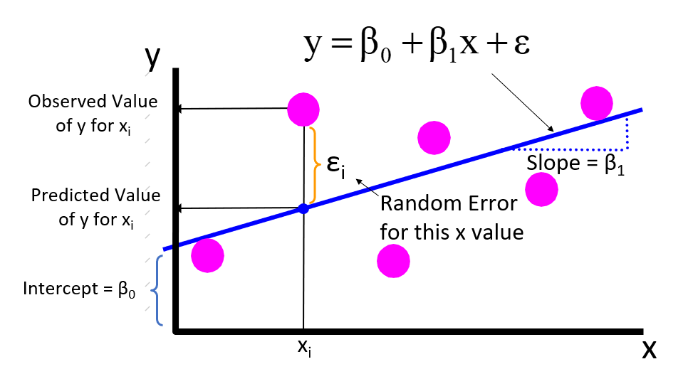
THE OBSERVED &PREDICTED VALUES
Notes:
Step1: Plot the graph of All the X(dependent variable) and y(independent variable)
Step2: Draw a straight line, such that the sum of the squared distances from all the points is minimal – This is the best fit line. This line must be as close as possible to all the points.
Step3: For the best fit line(which has minimal sum of squared distances) get the slope and the intercept. This is the best fit model of the given X and y
Training of the model in linear regression -> randomly choose the best value of x and y such that the line is as close as possible to all the points
Step4: This best fit line can be used to make predict - > for a given value of X what the value of y
The line goes through the core of the data since the parameters are obtained after minimizing the error function.
The above line the best fit for the data.
We can go ahead and use it for prediction, substitute X and you will get Y.

Slide 9
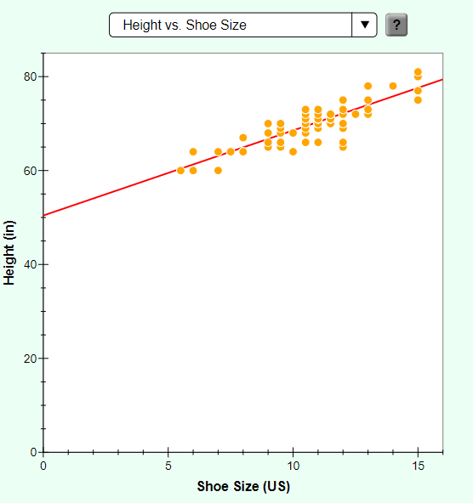
Explainability of the Linear model
Suppose, if we fit a straight like between the shoe size and height , best fit line would have a slope of 1.81 and intercept of 50.4
y = 1.81X + 50.4
This means that with 1 unit increase in x, y increases 1.81 times
In other words, with one unit increase in shoe size results in height increasing in 1.81 size

Slide 10
Performance for a Linear Model
Mean squared error – Sum of the squared distances between the actual and the predicted values. The best fit line tries to minimize this value. Also called as the bias
Avg(Square(y_test[i]-y_pred[i]))
R2 or variance score – Variance explained by the model
R2 = 1- (Residual Sum of Squares/Total sum of Squares)
Residual Sum of Squares = Sum of the Squared Error
= Sum(y_test-y_pred)2
Total Sum of Squares = Sum(y_pred- mean(y_pred))2

Slide 11
MULTIPLE LINEAR REGRESSION
Uses multiple features(x_{i}) are used to predict a continuous numeric target(y)
Formula for multiple linear regression is:
y = β₀ + β₁ x₁ + β₂ x₂ + ….. ϵ

Slide 12
Linear regression : demo

Slide 13
Logistic Regression

Slide 14
Supervised Learning
Supervised Learning
Regression
Classification
Notes:
Regression is used for predicting continuous values
Classification is used for predicting discrete values

Slide 15
Classification Algorithms
Classification Algorithms
Logistic Regression
Decision Tree
SVM
Random Forest
KNN
Naive Bayes

Slide 16
Types of Classification
Binary classification, e.g.:
Email – spam or not spam
Gaming – Win vs Loss
Sales – Buying vs Not buying
Loans – Default vs Non Default
Fraud identification – Fraud vs Non Fraud
Multi class classification, e.g.:
Image recognition – cat, dog, elephant
Number recognition – 1,2,3....
Voice recognition – speaker1, speaker2

Slide 17
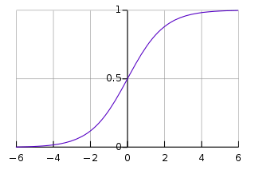
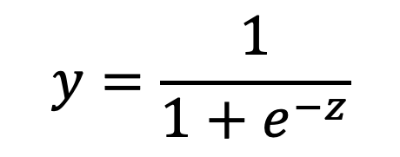
Logistic Regression
Used for Classification where the target is discrete
Equation for Logistic Regression also called as the log expression is
Y is between 0 and 1
Where
z is given by
Where x_{1,} x₂ x₃ … are features
y is the target
$$y=\frac{1}{1+e^{−z}}$$
Z = β₀ + β₁ x₁ + β₂ x₂ + ….. + ϵ
Sigmoid curve
X-axis : Z
Y-axis : Y(target)
Notes:
https://stats.idre.ucla.edu/other/mult-pkg/faq/general/faq-how-do-i-interpret-odds-ratios-in-logistic-regression/
https://www.youtube.com/watch?v=XnOAdxOWXWg&index=16&list=PLEiEAq2VkUULYYgj13YHUWmRePqiu8Ddy
https://towardsdatascience.com/logit-of-logistic-regression-understanding-the-fundamentals-f384152a33d1
https://www.dataschool.io/guide-to-logistic-regression/

Slide 18
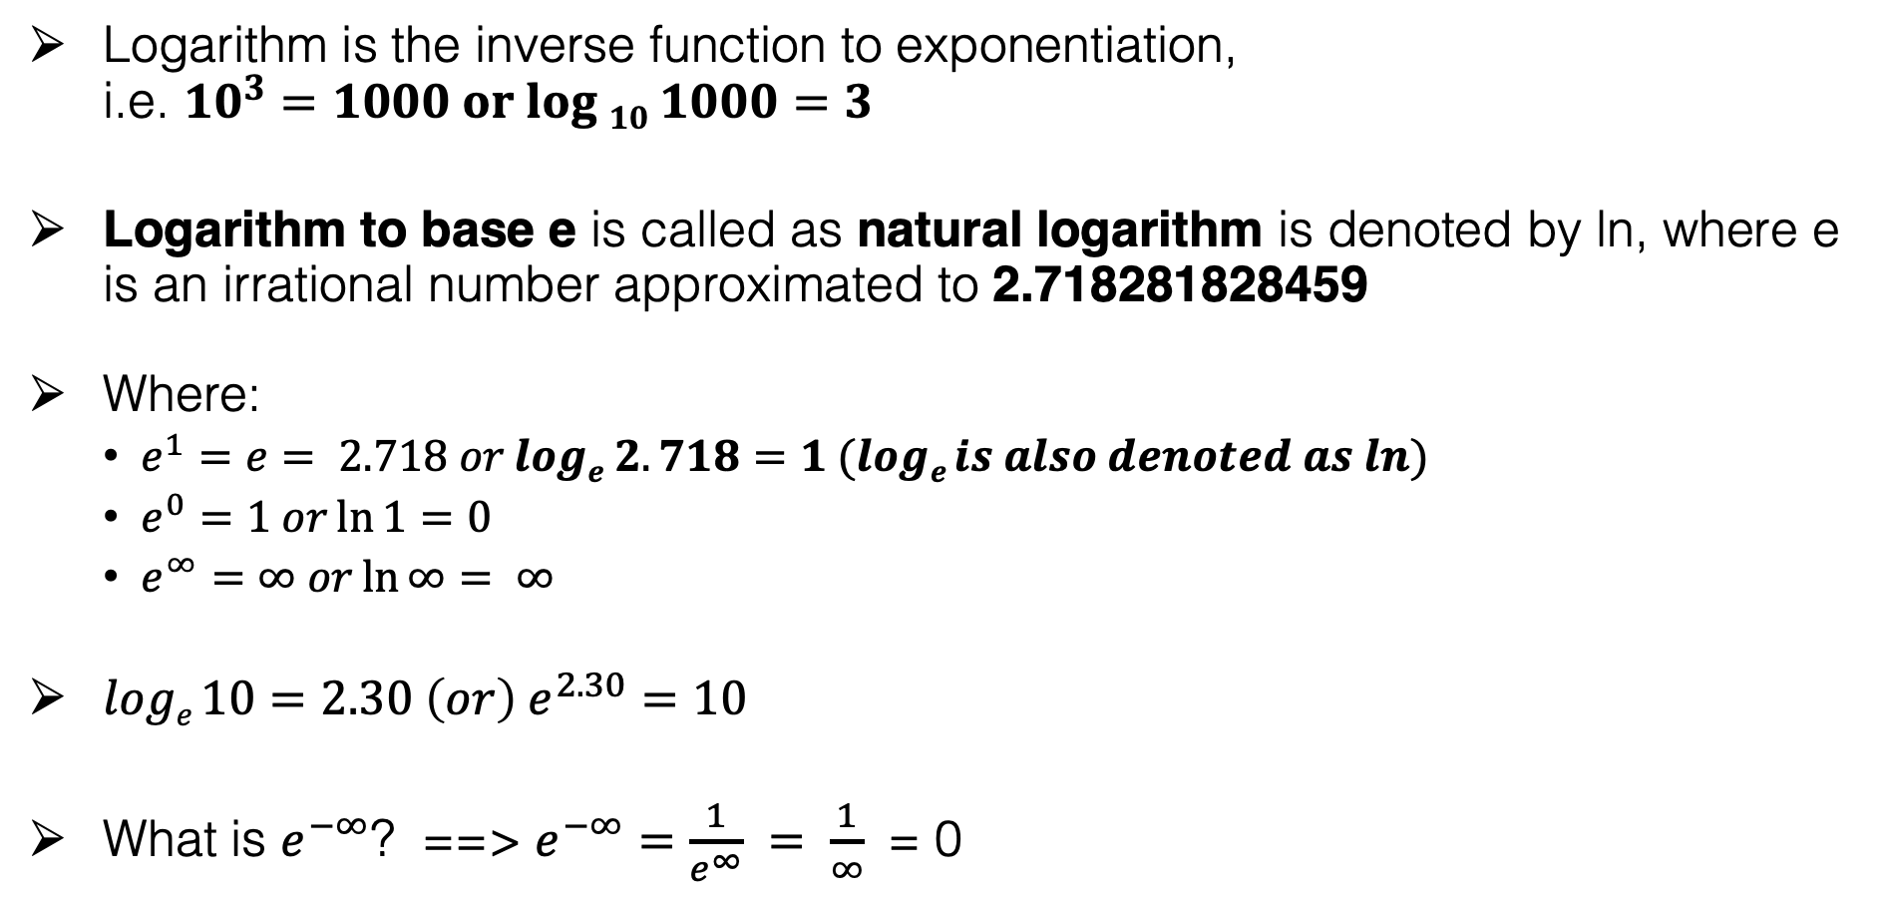
Logistic regression – Logarithm basics
Logarithm is the inverse function to exponentiation, i.e. ${10}^{3}=1000 or log 10 1000=3$
Logarithm to base e is called as natural logarithm is denoted by ln, where e is an irrational number approximated to 2.718281828459
Where:
$e^{1}=e= 2.718 orloge 2.718=1 (loge is also denoted as ln){}$
$e^{0}=1 or\ln{1}=0$
$e^{∞}=∞ or\ln{∞}= ∞$
$loge 10=2.30 \left(or\right) e^{2.30}=10$
What is $e^{−∞}$? ==> $e^{−∞}$ $=\frac{1}{e^{∞}} = \frac{1}{∞}$ = 0
Notes:
$e^{−∞}$ $=\frac{1}{e^{∞}} = \frac{1}{∞}$ = 0

Slide 19
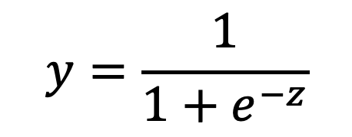
Logistic Regression
For all the features x_{1,} x₂ …. Get the right value of z by computing β_{0,} β_{1,} β_{2 ….}
Substitute the value of z in the equation
The above equation returns a value between 0 and 1
married | price | items | pur_value | income | purchase
1 | 25000 | 0 | 0 | 39171 | 0
0 | 20000 | 2 | 21866 | 249 | 1
0 | 30000 | 1 | 16090 | 1249 | 0
0 | 15000 | 0 | 0 | 7247 | 1
0 | 28000 | 2 | 26888 | 33314 | 1
1 | 14000 | 1 | 2800 | 0 | 0
1 | 20000 | 1 | 4035 | 27436 | 1
0 | 23000 | 1 | 15125 | 31514 | 0
0 | 14000 | 2 | 16415 | 8745 | 1
1 | 30000 | 2 | 5281 | 0 | 1
1 | 14000 | 0 | 0 | 0 | 0
Z = β₀ + β₁ x₁ + β₂ x₂ + ….. ϵ
$$y=\frac{1}{1+e^{−z}}$$

Slide 20


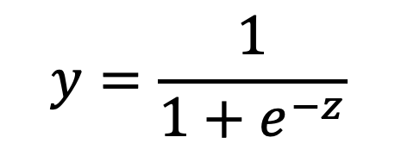
Logistic regression
Scenario : 1 – For large values of z
Suppose z = $∞$
$e^{−z}= e^{−∞}$ $=\frac{1}{e^{∞}} = \frac{1}{∞}$ = 0 ($∵ e^{∞}$ = $∞$)
$∴y=\frac{1}{1+0}$ = $\frac{1}{1}$ = 1
Hence for any large value of z, y $≈1$
Scenario : 2 – For small values of z
Suppose z = $−∞$
$e^{−z }{= e}^{∞}$ $=∞$ ($∵ e^{∞}$ = $∞$)
$∴y=\frac{1}{1+∞}$ = $\frac{1}{∞}=0$
Hence for any small value of z, y $≈0$
$$y=\frac{1}{1+e^{−z}}$$
Notes:
The logistic expression squishes the value between 0 and 1

Slide 21
Logistic regression
The equation for logistic regression called as the log function computes the value of y which is between 0 and 1
The value of y(target or the outcome) is approximated to either 0 or 1 which could be mapped to a label
For predicting if a person is going to purchase an item or not:
value of 0 : do not purchase
Value of 1 : purchase
married | price | items | pur_value | income | purchase
1 | 25000 | 0 | 0 | 39171 | 0
0 | 20000 | 2 | 21866 | 249 | 1
0 | 30000 | 1 | 16090 | 1249 | 0
0 | 15000 | 0 | 0 | 7247 | 1
0 | 28000 | 2 | 26888 | 33314 | 1
1 | 14000 | 1 | 2800 | 0 | 0
1 | 20000 | 1 | 4035 | 27436 | 1
0 | 23000 | 1 | 15125 | 31514 | 0
0 | 14000 | 2 | 16415 | 8745 | 1
1 | 30000 | 2 | 5281 | 0 | 1
1 | 14000 | 0 | 0 | 0 | 0

Slide 22
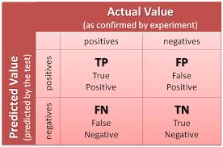
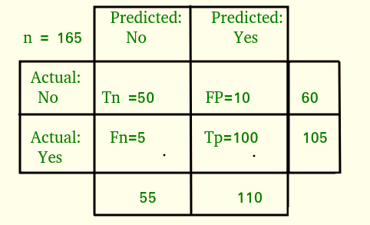
LOGISTIC REGRESSION - ACCURACY
Confusion matrix
Accuracy = Sum of diagonal values
--------------------------------
Total observations
Notes:
https://towardsdatascience.com/logistic-regression-detailed-overview-46c4da4303bc

Slide 23
Logistic regression : demo

Slide 24
THANK YOU
Copyright Manipal Global Education Services Pvt. Ltd. All Rights Reserved.
All product and company names used or referred to in this work are trademarks or registered trademarks of their respective holders. Use of them in this work does not imply any affiliation with or endorsement by them.
This work contains a variety of copyrighted material. Some of this is the intellectual property of Manipal Global Education, some material is owned by others which is clearly indicated, and other material may be in the public domain. Except for material which is unambiguously and unarguably in the public domain, permission is not given for any commercial use or sale of this work or any portion or component hereof. No part of this work (except as legally allowed for private use and study) may be reproduced, adapted, or further disseminated without the express and written permission of Manipal Global Education or the legal holder of copyright, as the case may be.

